Slide 1
Excel Case Study Data Analysis
Detailed Project Report
RAJAT CHAUHAN

Slide 2
PROJECT DETAIL
Project Title | Excel Case Study
Technology | Analytics – Excel Charts
Domain | Education
Project Difficulty level | Advanced
Tools Used | Excel

Slide 3
OBJECTIVE
The goal of this project is to solve the problem statements as per given excel data sets
To make excel charts for proper analysis and visualization of the data

Slide 4
PROBLEM STATEMENT
Analytics allow you to quantify the effects of making a change to your strategy, and that's invaluable to the process of improving and optimizing campaigns. The biggest benefit of utilizing proper analytics is being able to identify strengths and weaknesses.
Problem statements are mentioned along with the datasets in the given excel sheets. Please download the file and answer the questions.

Slide 5
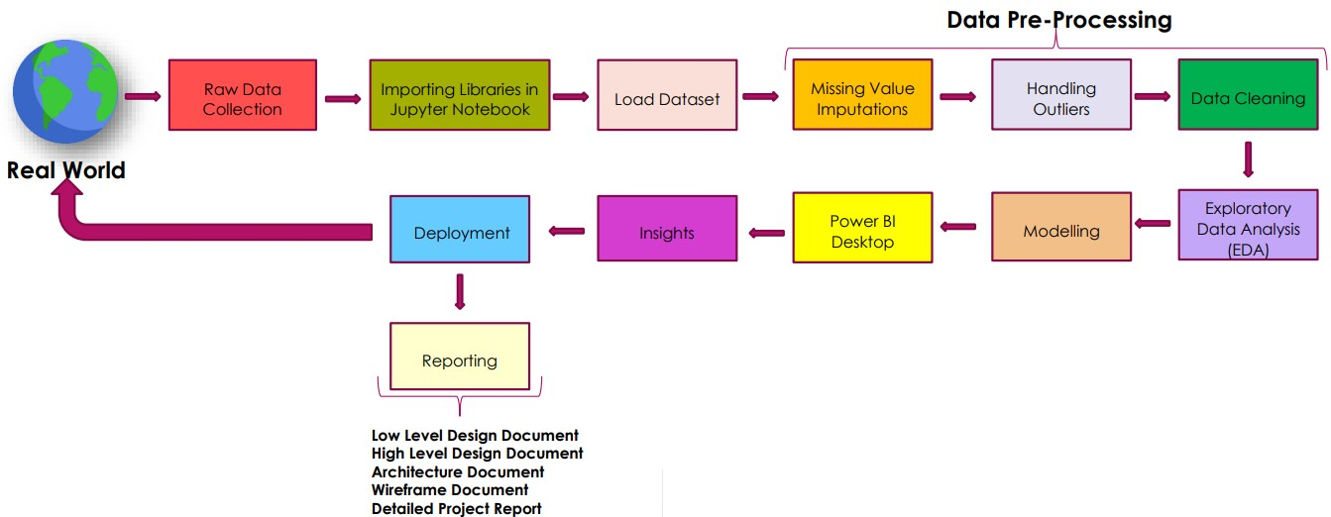
Architecture

Slide 6
DATASET INFORMATION
The Dataset was taken from iNeuron’s Provided Project Description Document.
https://drive.google.com/drive/folders/1VrH6EhC7c_KTZuTJcsp900X3l2h1mZiV

Slide 7
Detailed Description:
Following problem statements are mentioned along with the datasets in the given excel sheets.
https://drive.google.com/drive/folders/1VrH6EhC7c_KTZuTJcsp900X3l2h1mZiV
● Create a 3-dimensional column chart comparing sales data for men and women,
but omitting BMWs
● Create a chart to compare the favourite films data for 15-25 year old only (be
careful not to include any unnecessary blanks rows or columns in your selected
data).
● Create a chart which shows the top 6 countries and their medal hauls
Format this chart so that it is a pie chart, with the Barbarella slice "exploded" and
each segment labelled:
● Select the necessary ranges of data to create a 3-D cone chart showing the City
and the Population

Slide 8

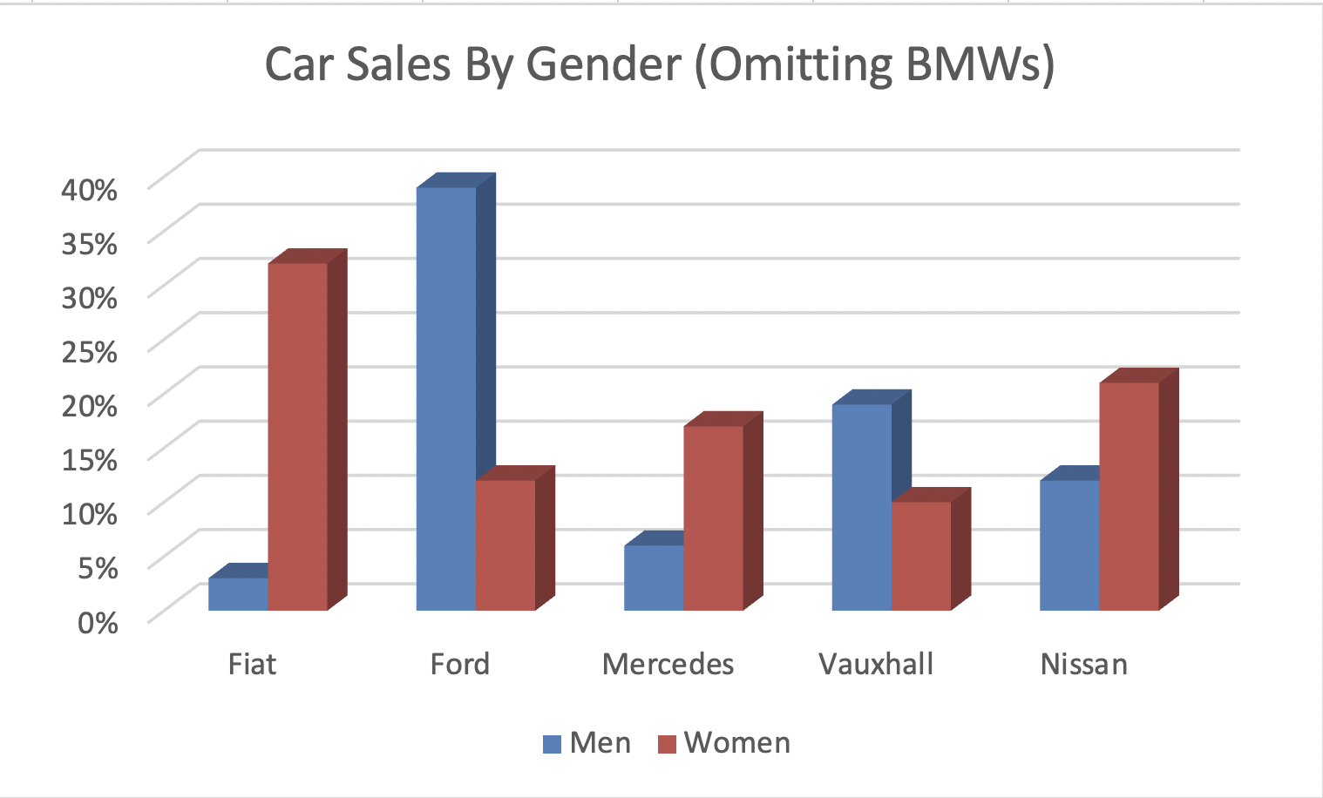
Charts
Car Sales By
Gender

Slide 9
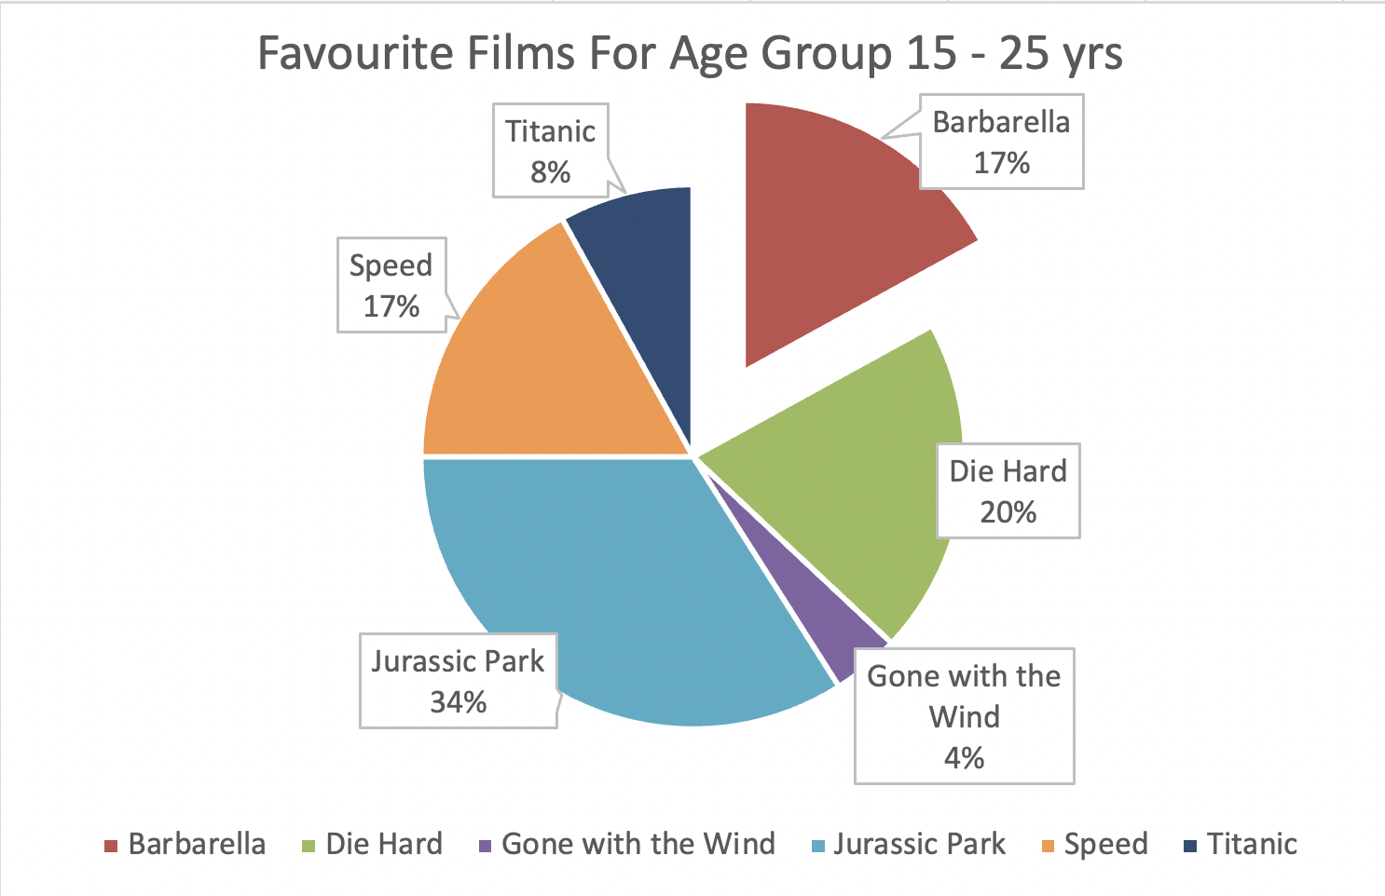
2. Favorite films For Age Group 15-25 years

Slide 10
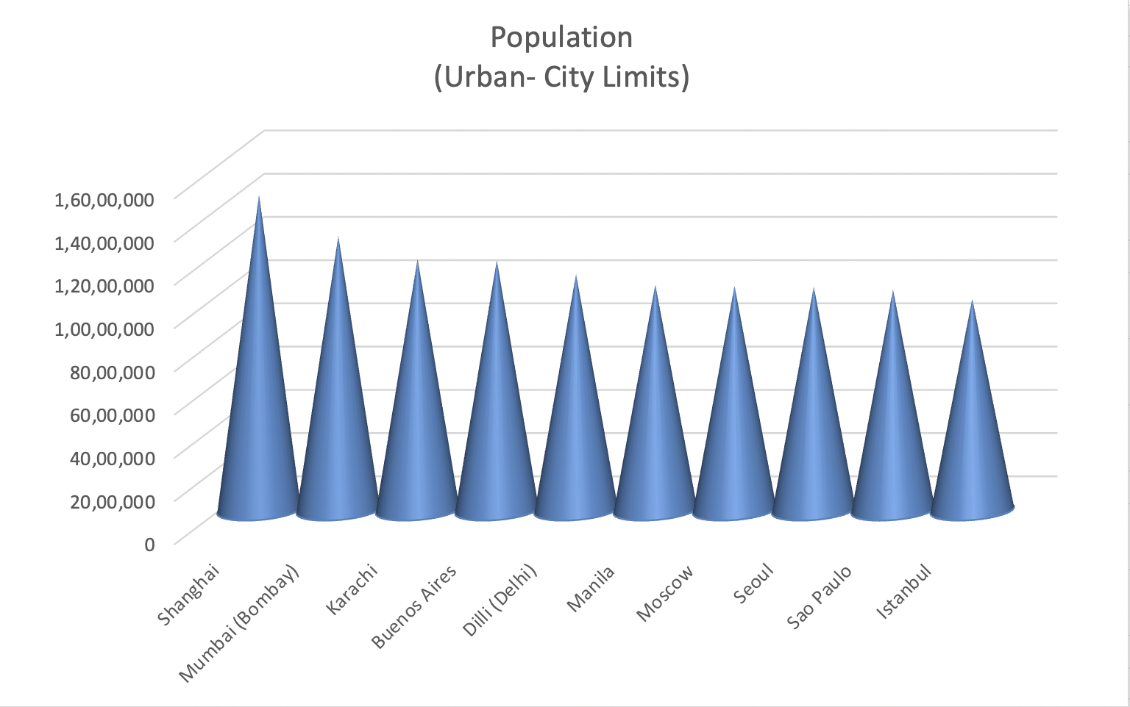
3. Population (Urban-City Limits)

Slide 11
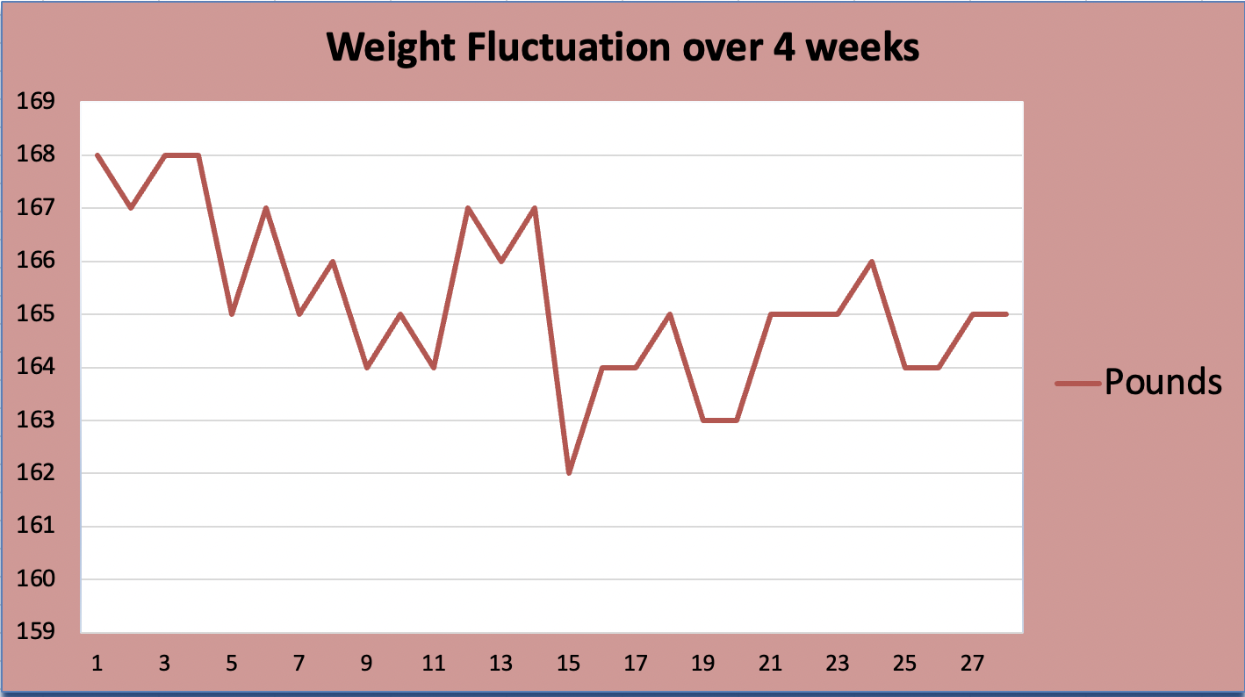
4. Weight Fluctuation over 4 weeks

Slide 12
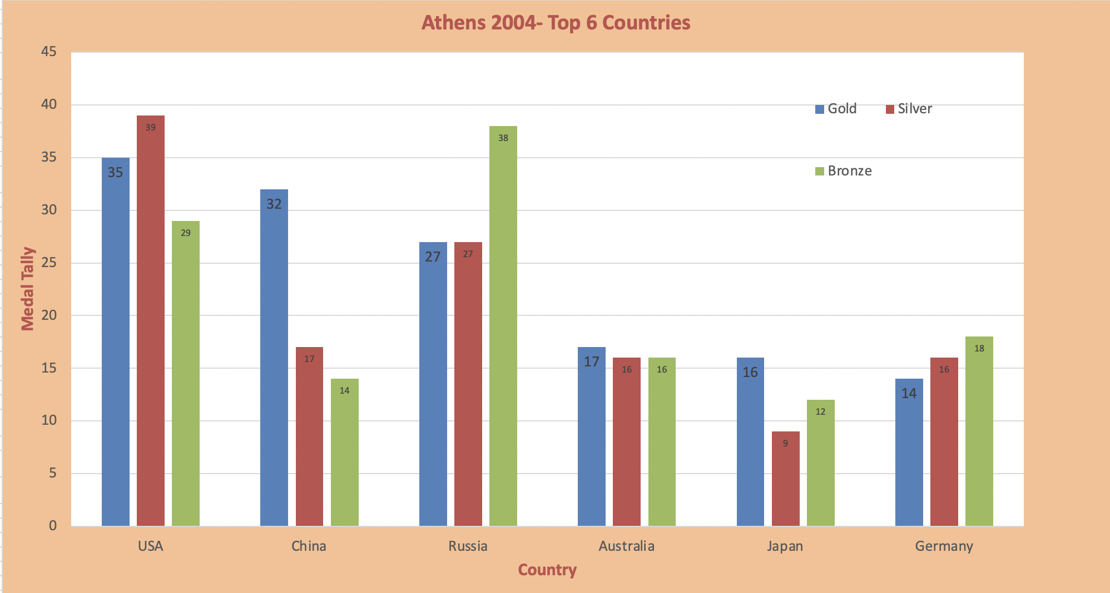
5. Athens 2004- Top 6 Countries

Slide 13
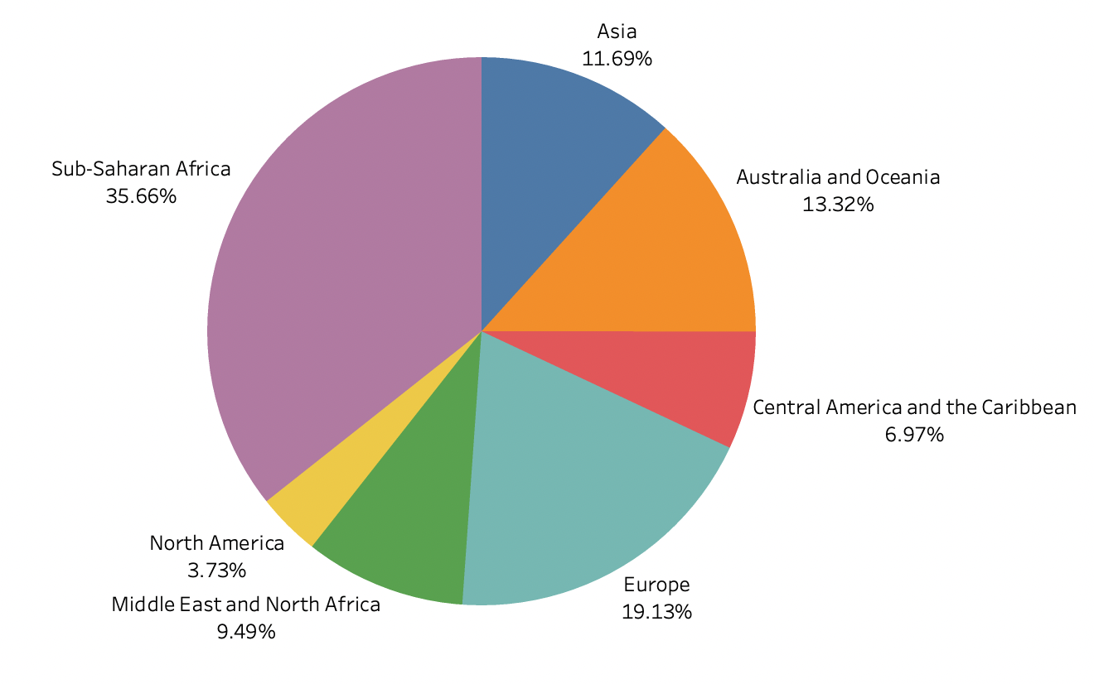
6. Region vs Count
Sub-Saharan Africa have most units Sold
Least can be seen in North America

Slide 14
Q & A
Q1) What’s the source of data?
Ans) The Dataset was taken from iNeuron’s Provided Project Description Document.
https://drive.google.com/drive/folders/1VrH6EhC7c_KTZuTJcsp900X3l2h1mZiV
Q2) What was the type of data?
Ans) The data was the combination of numerical and Categorical values in excel sheets
Q 3) What’s the complete flow you followed in this Project?
Ans) Refer slide 5th for better Understanding
Q4) What techniques were you using for data?
Ans) Advance Excel Charts

